Slide 1
Prim’s Algorithm
Maintains a set A containing edges selected so far. The edges in set A always form a single tree on nodes V_{A}
Starts from an arbitrary “root”: V_{A} = {a}
At each step:
  Find a cheap edge in the cut for V_{A}
  Add this edge to A
  Repeat until the tree spans all nodes
b
8
c
7
d
4
9
2
a
11
i
4
14
e
8
7
6
10
h
g
f
1
2

Slide 2
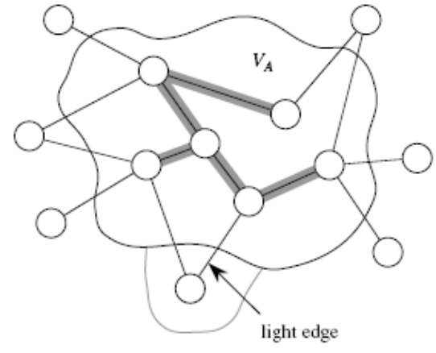
Find Light Edges Quickly?
Use a priority queue Q:
Contains nodes not yet
included in the tree, i.e., (V – V_{A})
  V_{A} = {a}, Q = {b, c, d, e, f, g, h, i}
Associate a key with each node v:
key[v] = minimum weight of any edge (u, v) connecting v to V_{A}
b
8
c
7
d
4
9
2
a
11
i
4
14
e
8
7
6
10
h
g
f
1
2
Key[a]=min(w₁,w₂)
w₁
a
w₂

Slide 3
Find Light Edges Quickly? (cont.)
After adding a new node to V_{A} update the weights of all nodes adjacent to it
  e.g., after adding a to the tree, k[b]=4 and k[h]=8
Key of v is ∞ if v is not adjacent to any nodes in V_{A}
b
8
c
7
d
4
9
2
a
11
i
4
14
e
8
7
6
10
h
g
f
1
2

Slide 4
Example
∞
∞
∞
b
8
c
7
d
0 ∞ ∞ ∞ ∞ ∞ ∞ ∞ ∞
Q = {a, b, c, d, e, f, g, h, i}
V_{A} = ∅
Extract-MIN(Q) ⇒ a
4
9
∞
2
∞
a
11
i
4
14
e
8
7
6
10
h
g
f
1
2
∞
∞
∞
4
∞
∞
∞
key [b] = 4 π [b] = a
key [h] = 8 π [h] = a
4 ∞ ∞ ∞ ∞ ∞ 8 ∞
Q = {b, c, d, e, f, g, h, i} V_{A} = {a}
Extract-MIN(Q) ⇒ b
b
8
c
7
d
4
9
∞
2
∞
a
11
i
4
14
e
8
7
6
10
h
g
f
1
2
∞
∞
∞
8

Slide 5
Example
8
key [c] = 8 π [c] = b
key [h] = 8 π [h] = a - unchanged
8 ∞ ∞ ∞ ∞ 8 ∞
Q = {c, d, e, f, g, h, i} V_{A} = {a, b}
Extract-MIN(Q) ⇒ c
4
∞
∞
b
8
c
7
d
4
9
∞
2
∞
a
11
i
4
14
e
8
7
6
10
h
g
f
1
2
∞
8
∞
key [d] = 7 π [d] = c
key [f] = 4 π [f] = c
key [i] = 2 π [i] = c
7 ∞ 4 ∞ 8 2
Q = {d, e, f, g, h, i} V_{A} = {a, b, c}
Extract-MIN(Q) ⇒ i
8
7
4
∞
b
8
c
7
d
4
2
9
∞
2
∞
a
11
i
4
14
e
8
7
6
10
h
g
f
1
2
8
∞
∞
4

Slide 6
Example
4
8
7
key [h] = 7 π [h] = i
key [g] = 6 π [g] = i
7 ∞ 4 6 8
Q = {d, e, f, g, h} V_{A} = {a, b, c, i}
Extract-MIN(Q) ⇒ f
b
8
c
7
d
4
9
2
2
∞
a
11
i
4
14
e
8
7
6
10
h
g
f
1
2
8
∞
4
7
6
4
8
7
key [g] = 2 π [g] = f
key [d] = 7 π [d] = c unchanged
key [e] = 10 π [e] = f
7 10 2 8
Q = {d, e, g, h} V_{A} = {a, b, c, i, f}
Extract-MIN(Q) ⇒ g
b
8
c
7
d
4
9
10
2
2
∞
a
11
i
4
14
e
8
7
6
10
h
g
f
1
2
7
6
4
2

Slide 7
Example
4
8
7
key [h] = 1 π [h] = g
7 10 1
Q = {d, e, h} V_{A} = {a, b, c, i, f, g}
Extract-MIN(Q) ⇒ h
b
8
c
7
d
4
9
10
2
2
a
11
i
4
14
e
8
7
6
10
h
g
f
1
2
7
2
4
7 10
Q = {d, e} V_{A} = {a, b, c, i, f, g, h}
Extract-MIN(Q) ⇒ d
1
4
8
7
b
8
c
7
d
4
9
10
2
2
a
11
i
4
14
e
8
7
6
10
h
g
f
1
2
1
2
4

Slide 8
Example
4
8
7
b
8
c
7
d
key [e] = 9 π [e] = f
9
Q = {e} V_{A} = {a, b, c, i, f, g, h, d}
Extract-MIN(Q) ⇒ e
Q = ∅ V_{A} = {a, b, c, i, f, g, h, d, e}
4
9
9
2
2
10
a
11
i
4
14
e
8
7
6
10
h
g
f
1
2
1
2
4

